Slide 1
Sensor Glove
Akash Kumar

Slide 2
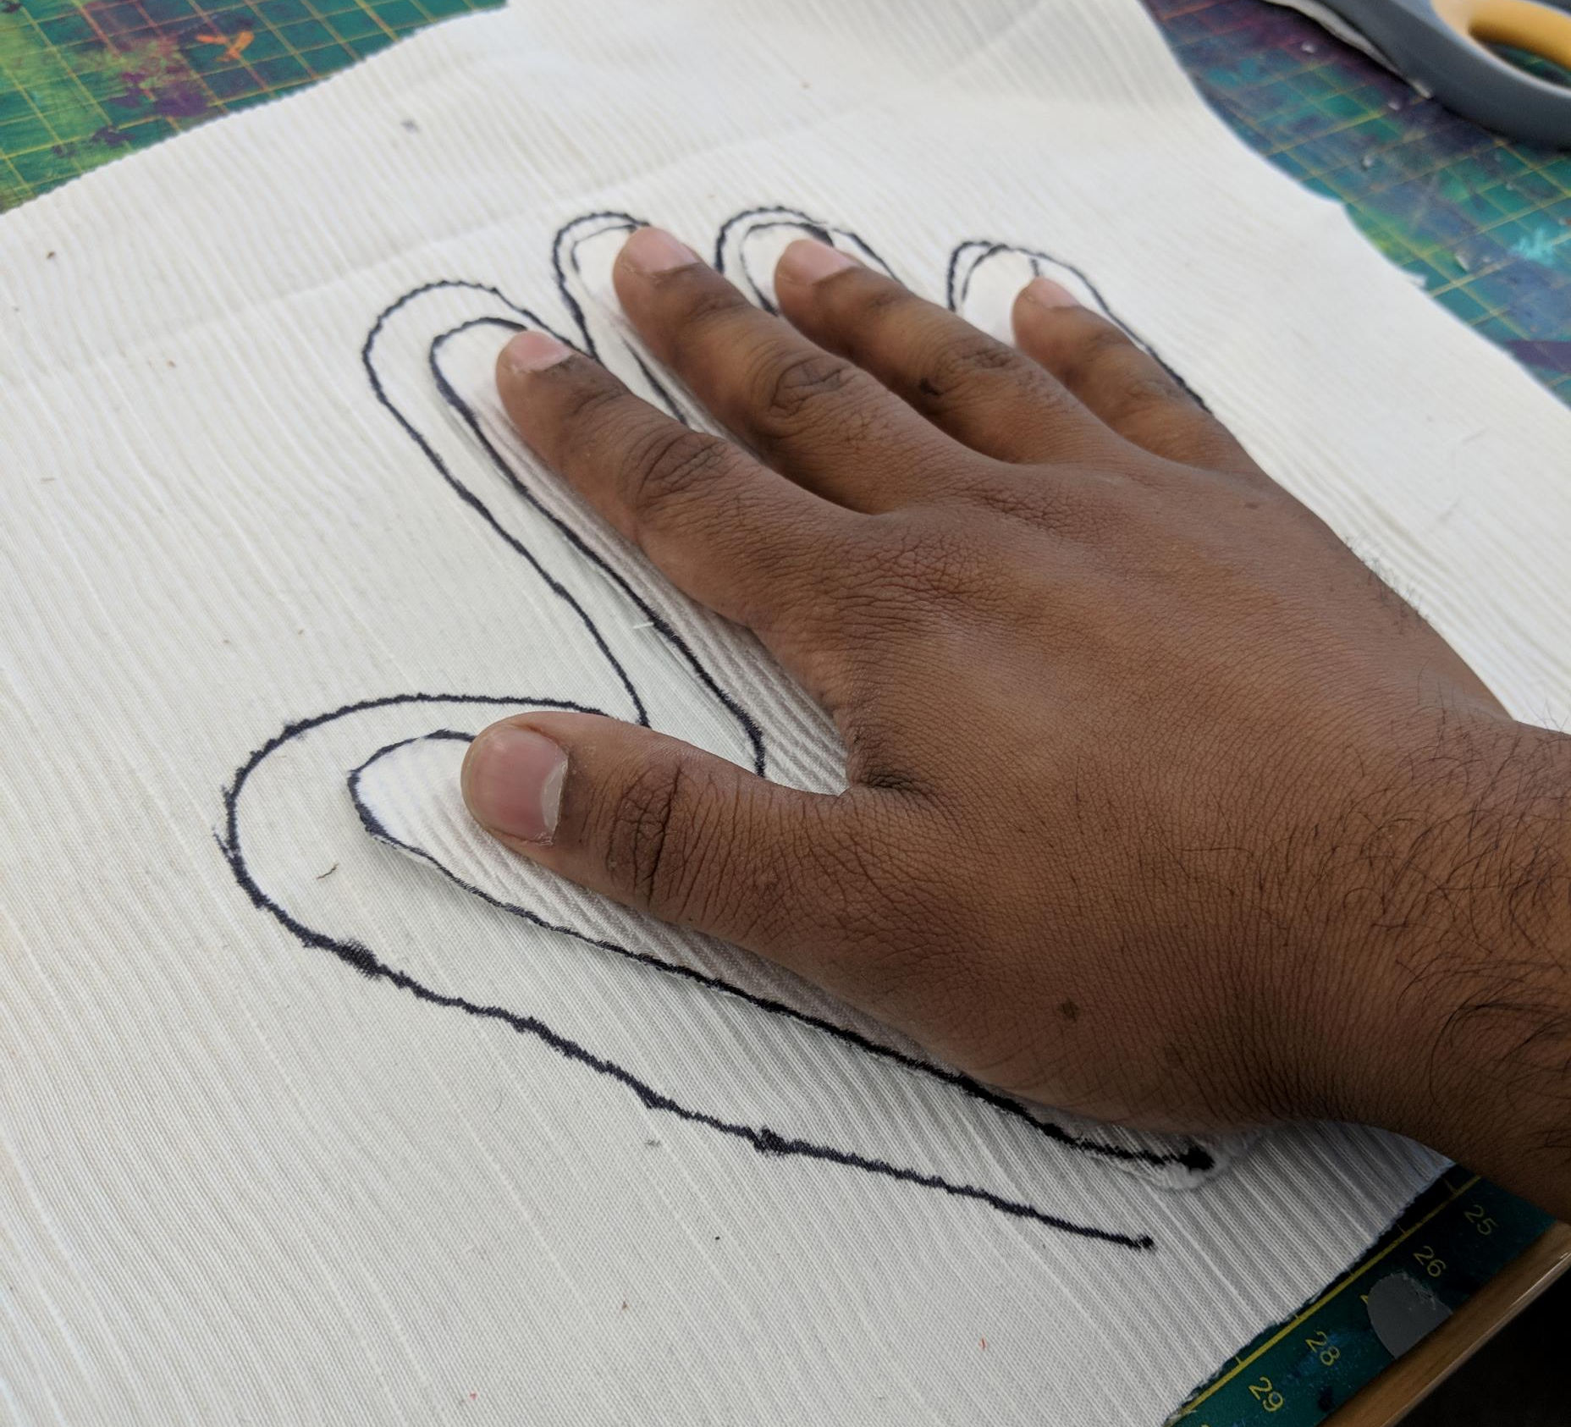
What I made
A glove that can detect the vitals of another person
Made with
Arduino Flora
Piezo Heart rate sensor
GSR sensor made from conductive fabric
Temperature Sensor made from wires

Slide 3
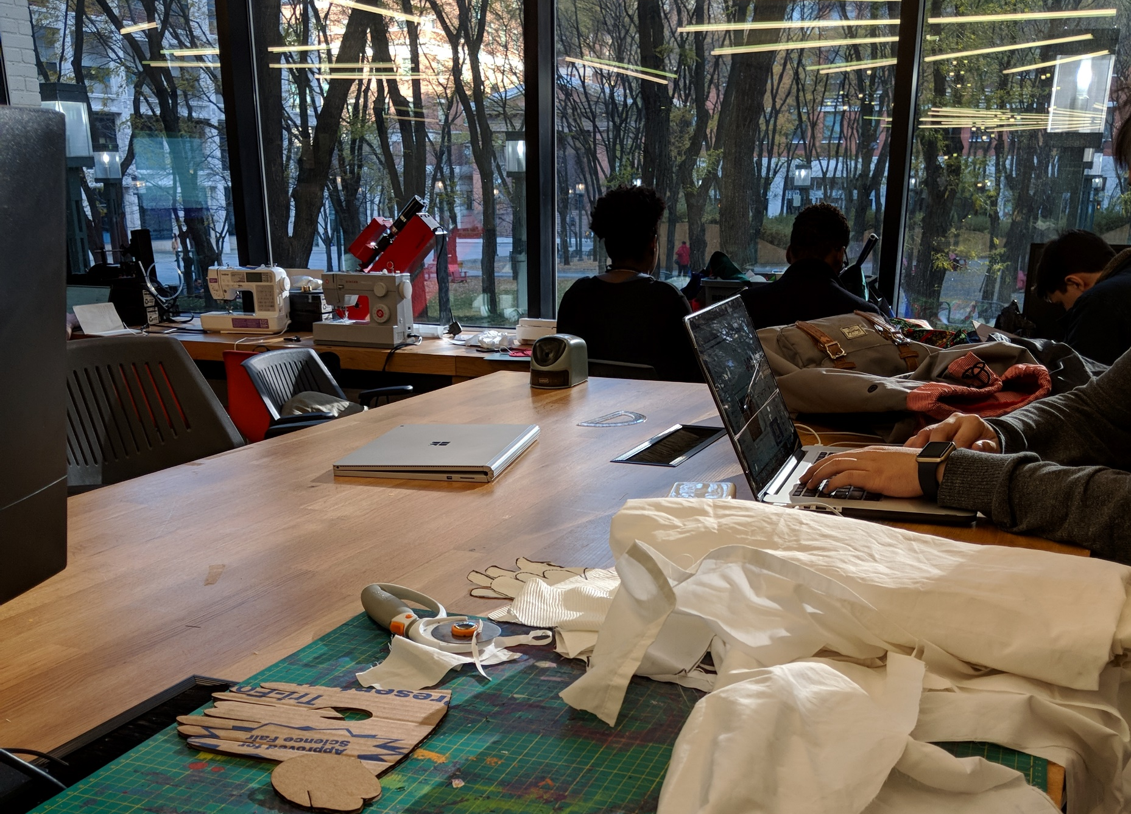
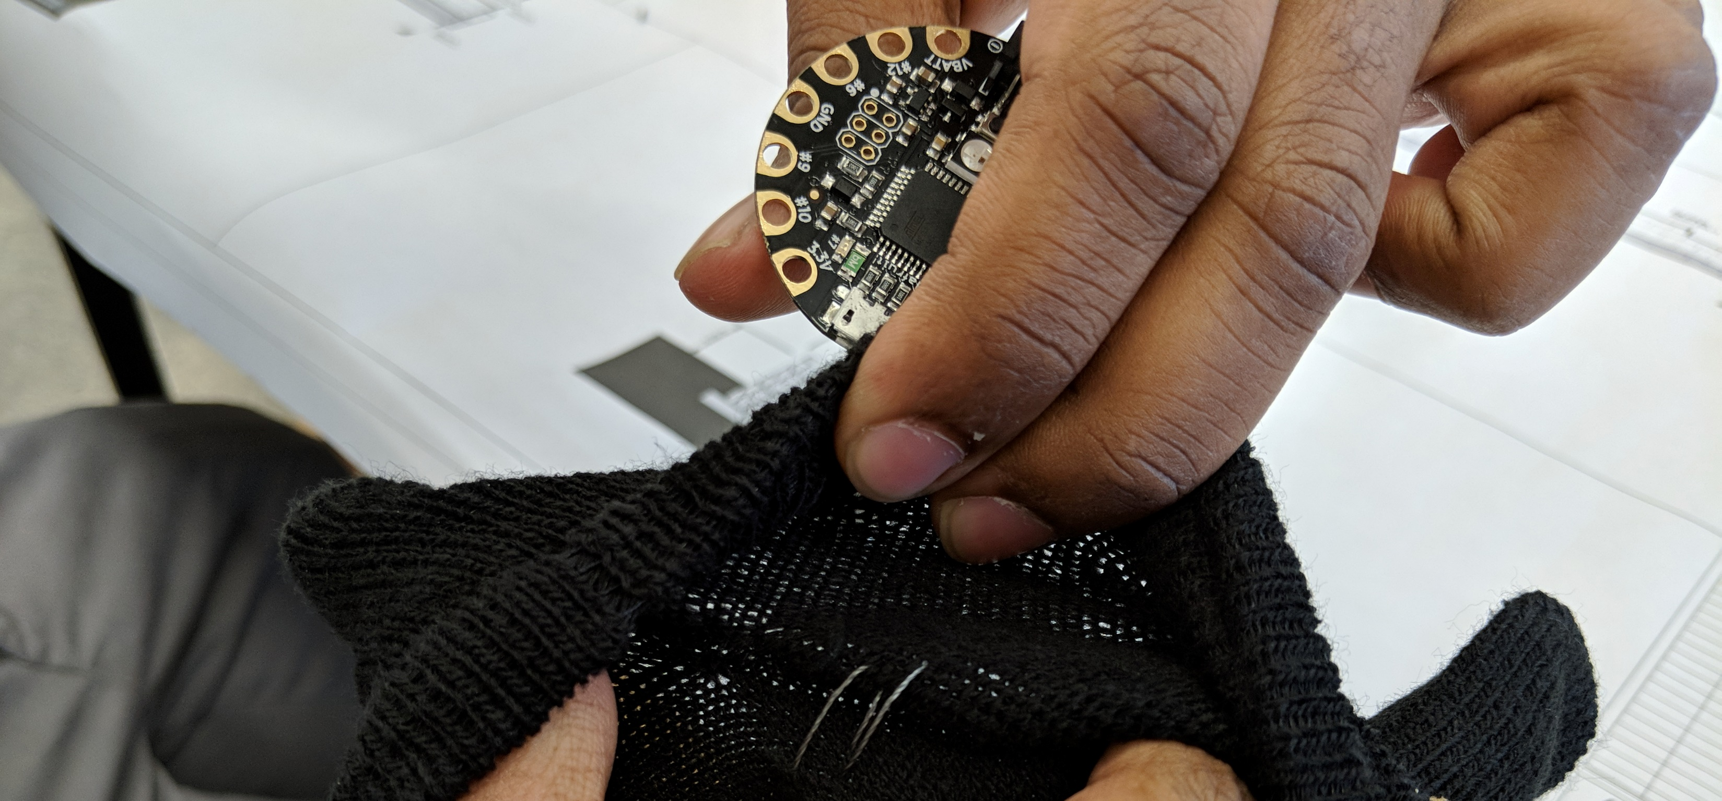
Issues
Actually made a huge mess
Can’t sew well
Unreliable sensors
Intuitive Interactions

Slide 4
Who is it for
Anyone with the need to get approximate vitals from another person
Parents
Doctors
Schools
Public events
Airports

Slide 5
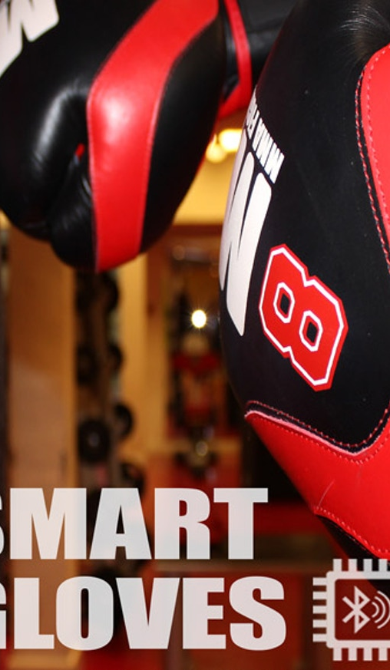
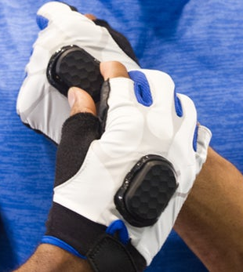
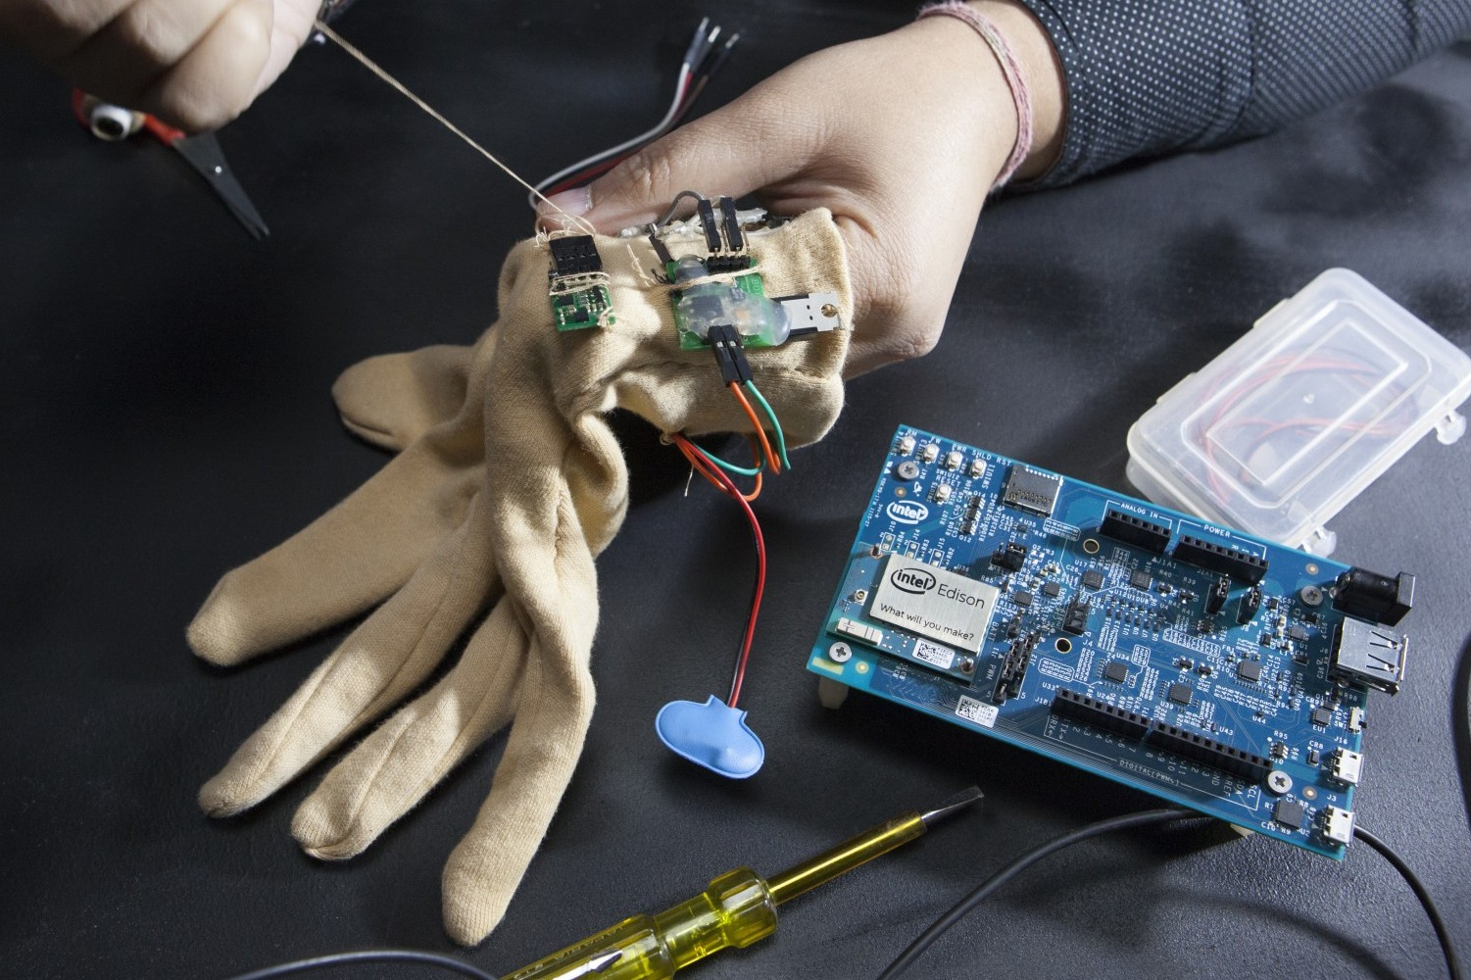
Research & Similar work
EEG Glove (Intel)
Fight Glove (Kickstarter)
Smart Workout Gloves (PureCarbon)
The Ability Project (NYU)

Slide 6
User Testing
Ambidextrous
Sew it instead of soldering it
More accurate
More intuitive feedback
Switch sensor positions

Slide 7
Future Implications
Easier access to temporary and non-stored vitals data
01
Quicker diagnosis of larger problems
02

